Slide 1
Page With No Likes [Facebook SQL Interview Question]
DataLamur by Joshua Kab

Slide 2
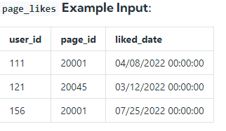
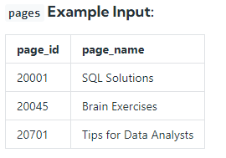
Assume you're given two tables containing data about Facebook Pages and their respective likes (as in "Like a Facebook Page"). Write a query to return the IDs of the Facebook pages that have zero likes. The output should be sorted in ascending order based on the page IDs.
Assumption:
There are no duplicates in the candidates table.

Slide 3
Query
SELECT page_id
FROM pages
WHERE page_id NOT IN (SELECT page_id FROM page_likes )

Slide 4
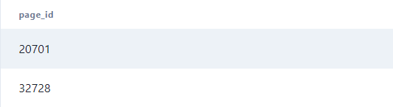
Result

Slide 5



follow us

